Slide 1
Retrofitting Tests
Tony Baines

Slide 2
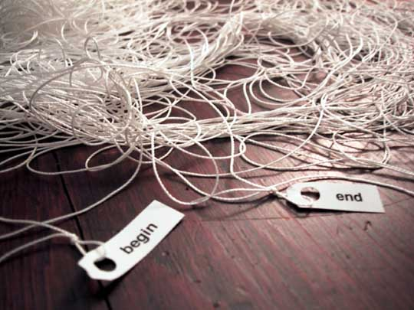
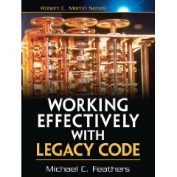
Legacy Code
We don’t always start with a clean sheet of paper.
“Our summer student put this together – can you make these changes …”
Sometimes ‘tactical’ becomes ‘strategic’
“This tool is essential to the platform – we need you to fix it!”
We never stop learning.
“It’s about that system you wrote 6 years ago …”
Working Effectively with Legacy Code (Michael Feathers)

Slide 3
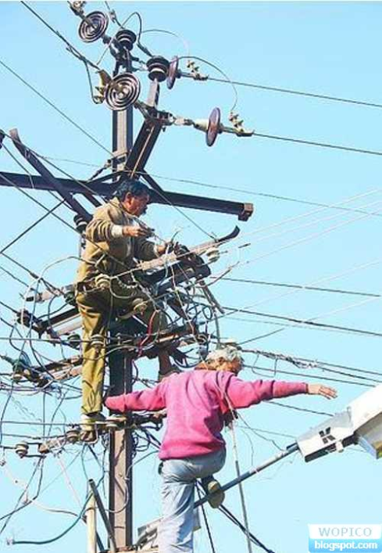
Risky Business
Some jobs are safer than others
How do I make my life a little safer?
Is it worth the cost?

Slide 4

The Cost Of Change
Changing unknown code can be a leap of faith
I want to make it cleaner, but how do I know I won’t break it?
… and I’m certain I’ll be back again next month
For my next trick, I will require the use of a safety net

Slide 5

Weaving the net
Find the code you need to change
Get it to compile on it’s own (no collaborators)
May need mocks, stubs or language tricks
Breaking Dependencies
Guess a behaviour and capture with an assertion
Characterisation tests
Repeat guess and test for happy and sad paths
Coverage tools can help

Slide 6
Breaking dependencies
Some useful refactorings
Subclass and override method
Expose static method
Parameterise constructor
Extract and override call
Introduce static setter
Adapt parameter

Slide 7
Subclass and override method
If the class you want to test has just one or two methods that make it hard to test in isolation
OneBadApple
getRandomNumber()
MyBadApple
getRandomNumber()

Slide 8
Expose static method
Change an instance method that doesn't make use of any instance variables into a static method and call it in the test case.
Useful where it's hard to get an instance of the class under test and there’s significant logic in the candidate method.

Slide 9
Parameterise constructor
Introduce an overloaded constructor that allows expensive dependencies to be injected, use this constructor for testing
Make a copy of the expensive constructor
Add a parameter to the copy to allow a dependency to be injected, remove the call to new ...()
Change the original constructor to delegate to the new constructor, passing in the instance it creates with new ...()
Use the new constructor in your test case, injecting a subclass (e.g. anonymous inner class of the class under test, overriding the with stub behaviour

Slide 10
Extract and override call
Pull out the part of a method that makes it hard to test into a new method, then subclass and override the new method to test the original method more easily.
OneComplicatedCallOut
isThisMyLuckyDay()
OneComplicatedCallOut
isThisMyLuckyDay()
doNastyStuff()
Call doNastyStuff()
MyOneComplicatedCallOut
doNastyStuff()

Slide 11
Introduce static setter
Especially useful when dealing with dependencies on a Singleton [GoF].
Add a static setter method to inject an instance of the singleton, use it to replace expensive behaviour with a test-double
Add a new setter method to the Singleton that sets the value of the private instance field
Weaken the access permission on the Singleton constructor to allow subclassing
In the test case, call the static setter, injecting a subclass (e.g. anonymous inner class) of the class under test, overriding the with stub behaviour

Slide 12
Adapt Parameter
Use the Adaptor [GoF] pattern to extract an interface for the difficult parameter(s) defining just the subset of methods that are used in the production code.
Write a default implementation of the interface that delegates to the 'real' parameter
Create a new method in the production class that accepts the adapted parameters and contains the original business logic
Change the original method to uses the default implementation to wrap the original parameters and call the new method
Tests can call the new method with stub instances of the adaptor interface (perhaps with additional methods for sensing)

Slide 13

An Example

Slide 14
Overview
public class XMLSender {
XMLSender(Logger logger, String text, String messageID, String senderflag) {
this.logger = logger;
serviceProvider = JNDILookup.getInstance();
sendMessage(text, messageID, senderflag);
}
public void sendMessage(String text, String messageID, String senderflag) {
try {
queueConnectionFactory = serviceProvider
.getQueueConnectionFactory(MessageDrivenBean.JMS_FACTORY);
if (senderflag.equals("REDIRECT")) {
queue = serviceProvider.getQueue(MessageDrivenBean.REDIRECT_QUEUE);
}
else {
queue = serviceProvider.getQueue(MessageDrivenBean.RESPONSE_QUEUE);
}
queueConnection = queueConnectionFactory.createQueueConnection();
queueSession = queueConnection.createQueueSession(false,
Session.AUTO_ACKNOWLEDGE);
...
textMessage.setText(text);
textMessage.setStringProperty("messageId", messageID);
queueConnection.start();
queueSender.send(textMessage);
queueSession.close();
queueConnection.close();
}
catch (Exception e) {
logger.info("Unable to send message to the Queue",e);
MessageDrivenBean.sendMail(e.getMessage());
}
finally {
// Clean up
...
}
}
}

Slide 15
Constructor Challenges
Call-out to static factory method
XMLSender(Logger logger, String text, String messageID, String senderflag) {
this.logger = logger;
serviceProvider = JNDILookup.getInstance();
sendMessage(text, messageID, senderflag);
}
Call the business-logic method during construction
XMLSender(Logger logger, String text, String messageID, String senderflag) {
this.logger = logger;
serviceProvider = JNDILookup.getInstance();
sendMessage(text, messageID, senderflag);
}

Slide 16
Testing the Constructor
Create a subclass and override the business logic method
public class StubbedXMLSender extends XMLSender {
public static boolean wasSendMessageCalled = false;
StubbedXMLSender(Logger logger, String text, String messageID, String senderflag) {
super(logger, text, messageID, senderflag);
}
/*
* Override the sendMessage() method to allow the constructor to be tested
* on it's own
*/
@Override
public void sendMessage(String text, String messageID, String senderflag) {
wasSendMessageCalled = true;
}
}
Instantiate the subclass and assert using the sensing variable.
(The static factory method is still called though)
@Test
public void shouldBeAbleToInstantiateAnXMLSender() {
new StubbedXMLSender(null, null, null, null);
assertTrue(StubbedXMLSender.wasSendMessageCalled);
}

Slide 17
Business Logic
Switch on parameters
if (senderflag.equals("REDIRECT")) {
queue = serviceProvider.getQueue(MessageDrivenBean.REDIRECT_QUEUE);
}
else {
queue = serviceProvider.getQueue(MessageDrivenBean.RESPONSE_QUEUE);
}
Some boilerplate, and some real logic
queueConnection = queueConnectionFactory.createQueueConnection();
queueSession = queueConnection.createQueueSession(false,
Session.AUTO_ACKNOWLEDGE);
...
textMessage.setText(text);
textMessage.setStringProperty("messageId", messageID);
queueConnection.start();
queueSender.send(textMessage);
Error handling
catch (Exception e) {
logger.info("Unable to send message to the Queue",e);
MessageDrivenBean.sendMail(e.getMessage());
}

Slide 18
Testing the Business Logic
Mocks + Stubs
EasyMock
PowerMock
Mock constructors and static methods
The sledgehammer – great for breaking-up hard dependencies, a sign of problems if used for everyday jobs.
Treat test code like production code
Refactor duplication out
Keep tests small and focus
Characterisation tests != unit tests
Trying to capture existing behaviour
Expect to have to do more work
Use test-coverage tools to look for missed behaviour

Slide 19

And the payback is …
With my tests is place I can
Make these changes, and the next ones, and the next ones
Refactor
Add assertions to my build to stop the coverage from falling

Slide 20
